Slide 1
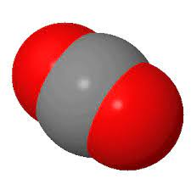
Carbon in the climate system: the atmospheric reservoir
Mostly CO₂ (415 ppm)
A little CH₄ (1.8 ppm)
CO (tiny amounts)
These are still “trace gases” but it adds up to billions of tons!

Slide 2
Carbon in the climate system: the atmospheric reservoir
Mostly CO₂ (415 419 ppm)
A little CH₄ (1.8 1.9 ppm)
CO (tiny amounts)
These are still “trace gases” but it adds up to billions of tons!

Slide 3
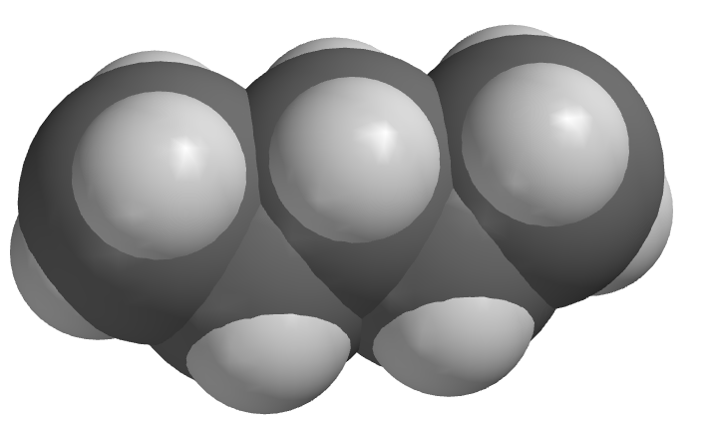
Carbon in the climate system: the solid reservoir
Carbonate minerals
Carbohydrates (methane, ethane, propane … )
What are carbonate minerals? The most familiar and common one is Calcium Carbonate, CaCO₃
2-
Carbonate
Carbohydrate

Slide 4


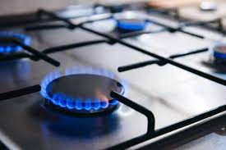
Forms of hydrocarbons you have seen (or smelled)

Slide 5


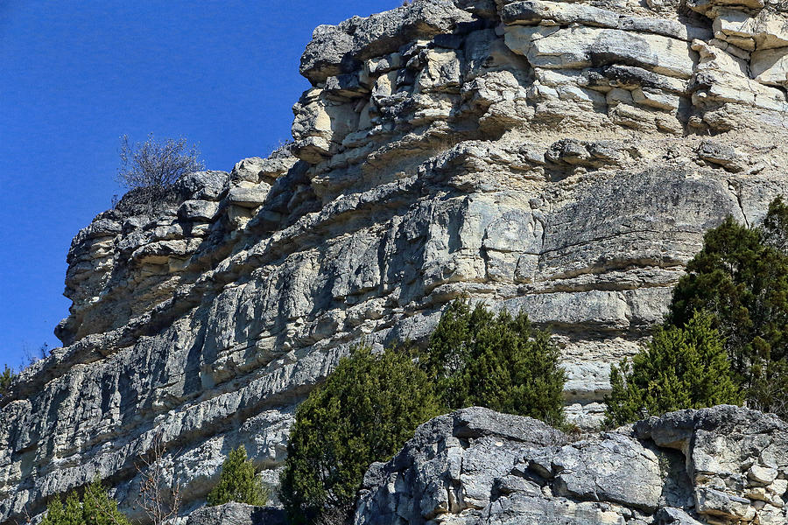

Forms of carbonate you have seen
Sea shells
Limestone
All these have the have carbonate in them.

Slide 6
Carbon in the climate system: the ocean reservoir
The carbon in the oceans mostly takes the form of bicarbonate
1-
Bicarbonate

Slide 7
Carbon in the climate system: the ocean reservoir
The carbon in the oceans mostly takes the form of bicarbonate
1-
Bicarbonate
(Different from Carbonate)
2-

Slide 8

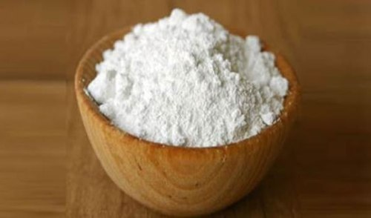
Forms of bicarbonate that you have seen
Baking soda has bicarbonate in it.

Slide 9
Charged vs non-charged forms of carbon in the climate system
Carbon Dioxide and methane
Bicarbonates
1-
Carbonates and hydrocarbons
Because carbonates and bicarbonates have a negative charge, they always occur in nature paired up with positively charged ions. So now we’ll learn about those.
2-

Slide 10
Elements that like to get a positive charge
All metals tend to lose electrons and become positively charged!

Slide 11
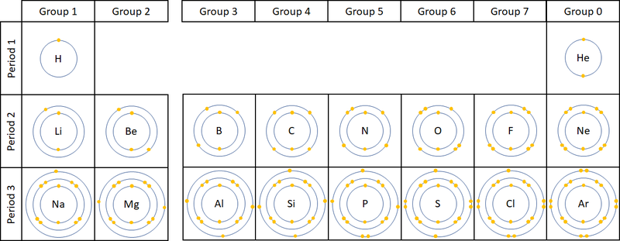
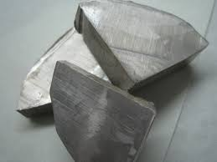
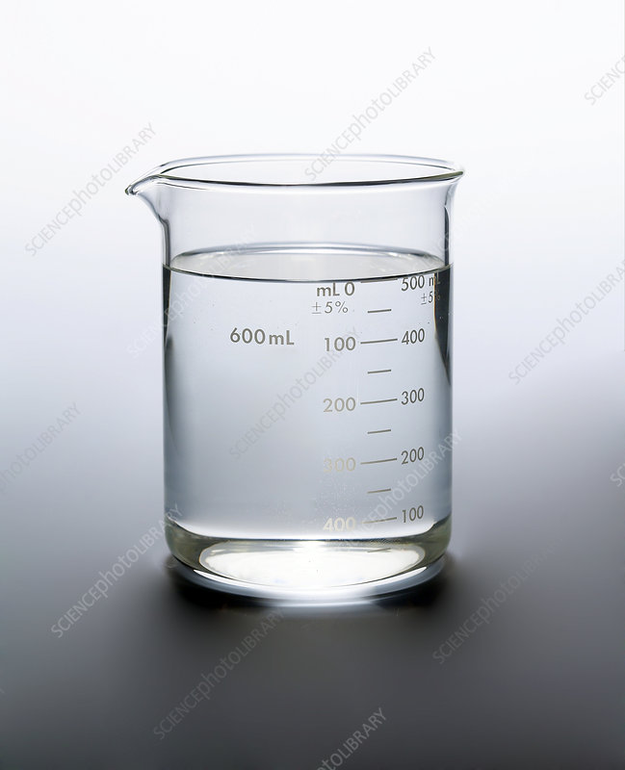
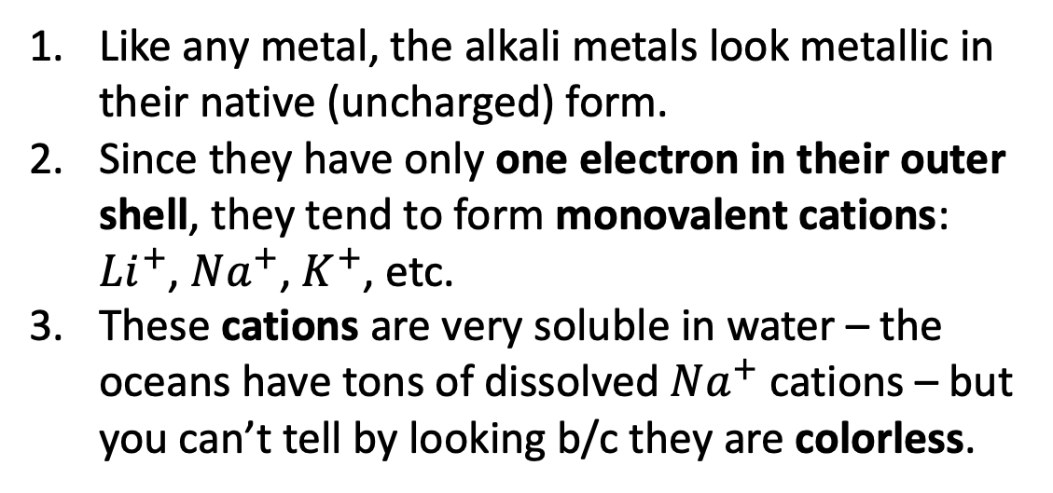
Group 1 elements: Alkali Metals
Like any metal, the alkali metals look metallic in their native (uncharged) form.
Since they have only one electron in their outer shell, they tend to form monovalent cations: $Li^{+}$, $Na^{+}$, $K^{+}$, etc.
These cations are very soluble in water – the oceans have tons of dissolved $Na^{+}$ cations – but you can’t tell by looking b/c they are colorless.

Slide 12
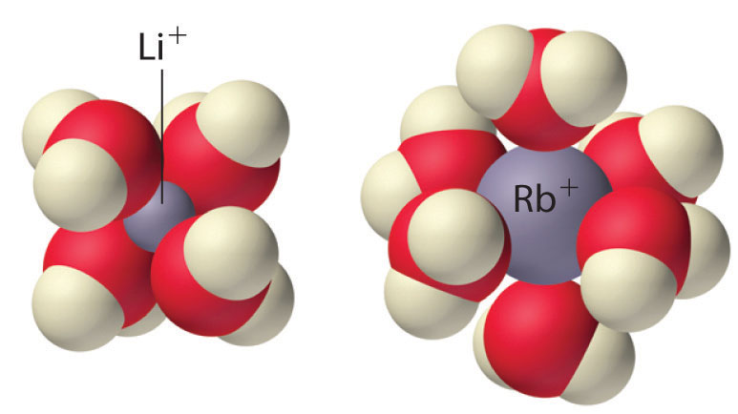


Group 1 elements: Aqueous alkali metal cations at the molecular level
$$K^{+}$$
Na⁺, K⁺, etc. behave similarly
$$HCO_{3}^{−}$$

Slide 13
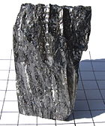
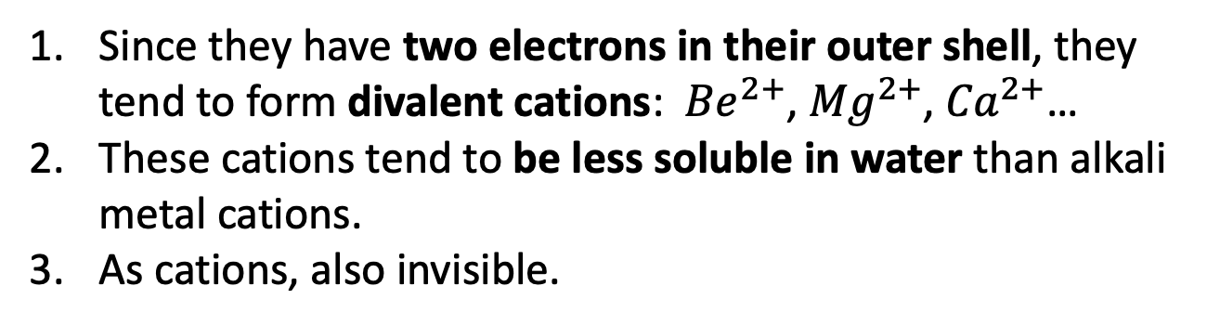
Group 2 elements: the Alkali Earth Metals
Since they have two electrons in their outer shell, they tend to form divalent cations: ${Be}^{2+}$, ${Mg}^{2+}$, ${Ca}^{2+}$…
These cations tend to be less soluble in water than alkali metal cations.
As cations, also invisible.

Slide 14
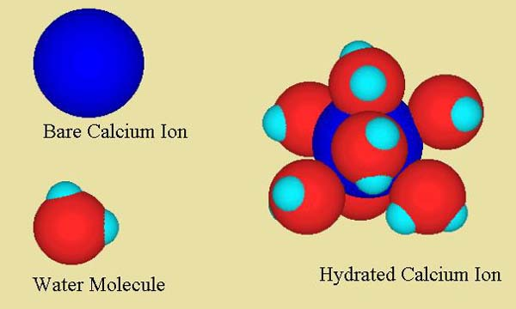
Group 2 elements: Aqueous alkali earth metal cations at the molecular level
Could also have Mg²⁺, Be²⁺, etc.
2+

Slide 15
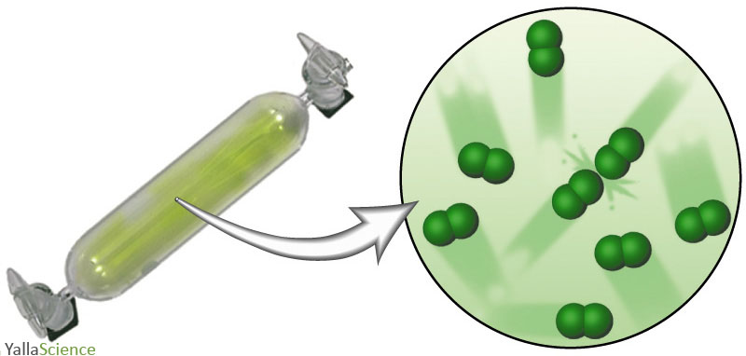
Group 7 elements: the Halogens

Slide 16
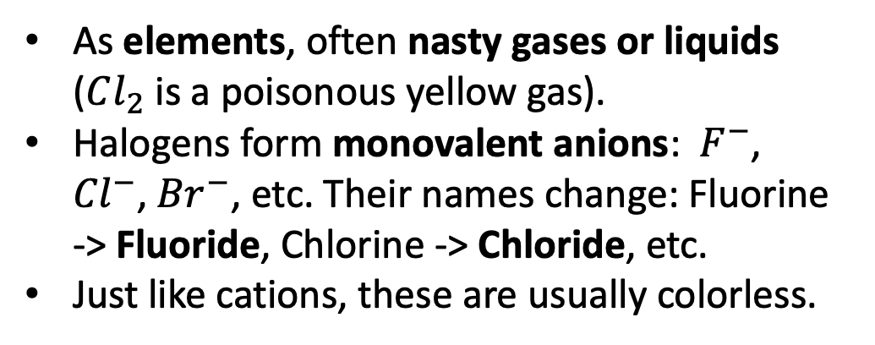
Group 7 elements: the Halides
As elements, often nasty gases or liquids ($Cl_{2}$ is a poisonous yellow gas).
Halogens form monovalent anions: $F^{−}$, ${Cl}^{−}$, ${Br}^{−}$, etc. Their names change: Fluorine -> Fluoride, Chlorine -> Chloride, etc.
Just like cations, these are usually colorless.

Slide 17
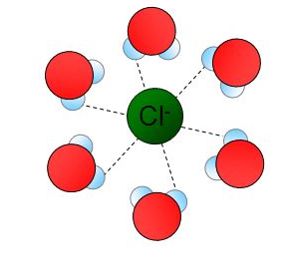
Group 7 elements: Halides at the molecular level
Could also have F⁻, Br⁻, etc.

Slide 18
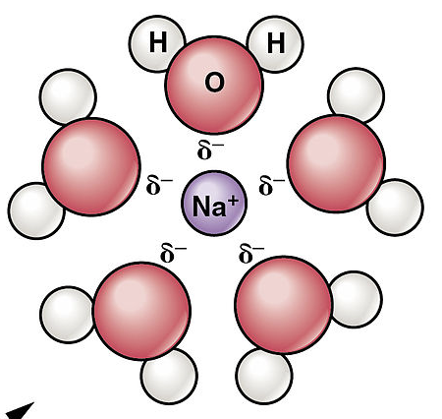

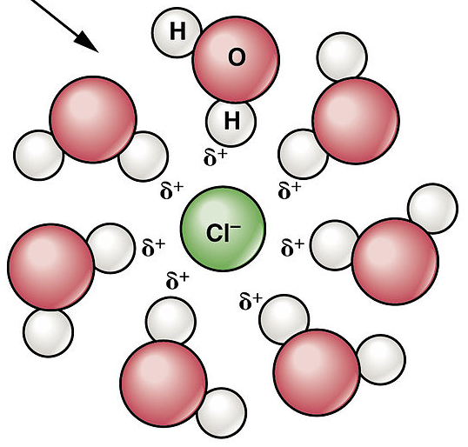
Principle of electrical neutrality
Negative ions (anions) and positive ions (cations) always combine in a way that produces net zero charge. That’s the principle of electrical neutrality.

Slide 19
Aqueous salts at the molecular level
Notice anything different about how the water molecules surround these ions?

Slide 20
Aqueous salts at the molecular level
It’s because the water molecules themselves have positive and negative parts! (We say that water is polarized.)

Slide 21
Aqueous salts at the molecular level
Symbolically, chemists refer to this combination as NaCl(aq). That’s pretty abbreviated notation considering what we really think is going on!

Slide 22


Electrical neutrality means carbonates and bicarbonates have to have some cations …
Carbon Dioxide and methane
Bicarbonates
1-
$$Na^{+}$$
Carbonates and hydrocarbons
$${Ca}^{2+}$$
2-

Slide 23
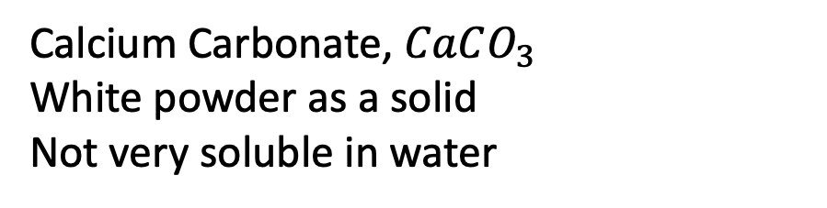

Calcium Carbonate is the most common carbonate on Earth
Calcium Carbonate, $CaCO_{3}$
White powder as a solid
Not very soluble in water
$${Ca}^{2+}$$
$$CO_{3}^{2−}$$

Slide 24

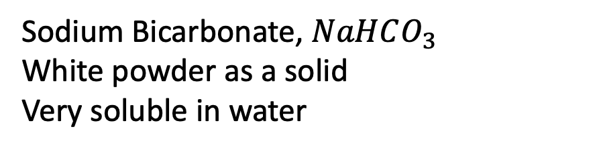
Sodium Bicarbonate is the most common bicarbonate on Earth (in the oceans)
Sodium Bicarbonate, $NaHCO_{3}$
White powder as a solid
Very soluble in water
$$Na^{+}$$

Slide 25
Here’s a more accurate way of showing carbon in the climate
Carbon Dioxide and methane
Bicarbonates
1-
$$Na^{+}$$
Carbonates and hydrocarbons
$${Ca}^{2+}$$
2-

Slide 26
Using the principle of electrical neutrality to predict chemical formulas
Chemical formula for …
Cesium Carbonate
Cesium Bicarbonate
Barium Carbonate
Strontium Bicarbonate

Slide 27
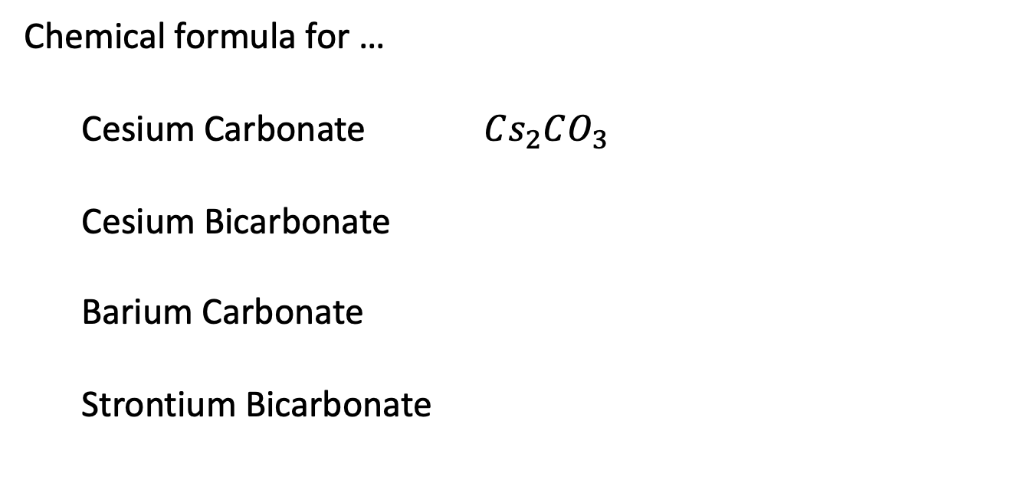
Using the principle of electrical neutrality to predict chemical formulas
Chemical formula for …
Cesium Carbonate $Cs_{2}CO_{3}$
Cesium Bicarbonate
Barium Carbonate
Strontium Bicarbonate

Slide 28
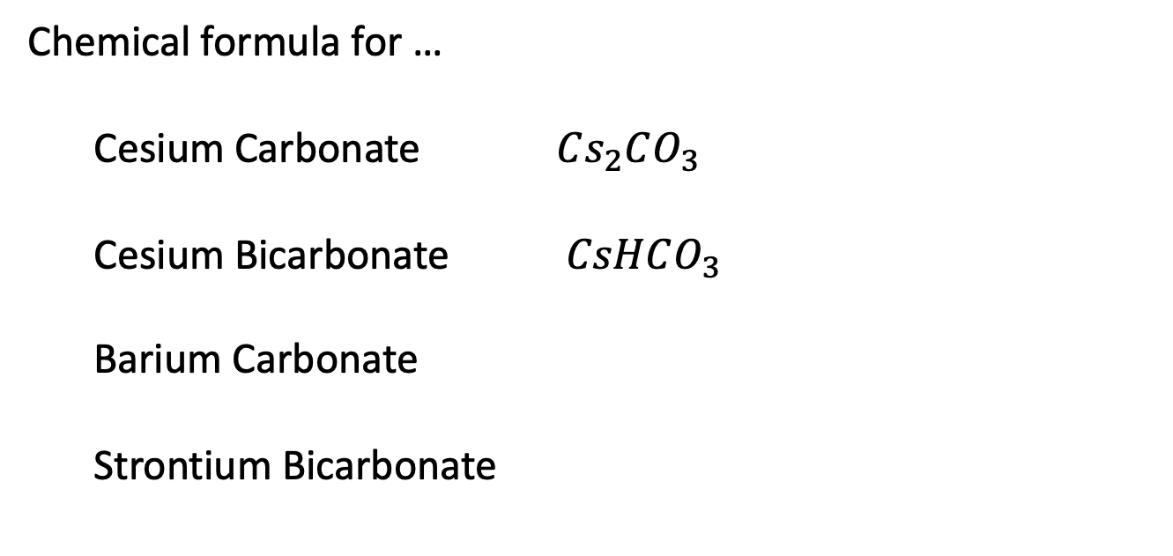
Using the principle of electrical neutrality to predict chemical formulas
Chemical formula for …
Cesium Carbonate $Cs_{2}CO_{3}$
Cesium Bicarbonate $CsHCO_{3}$
Barium Carbonate
Strontium Bicarbonate

Slide 29
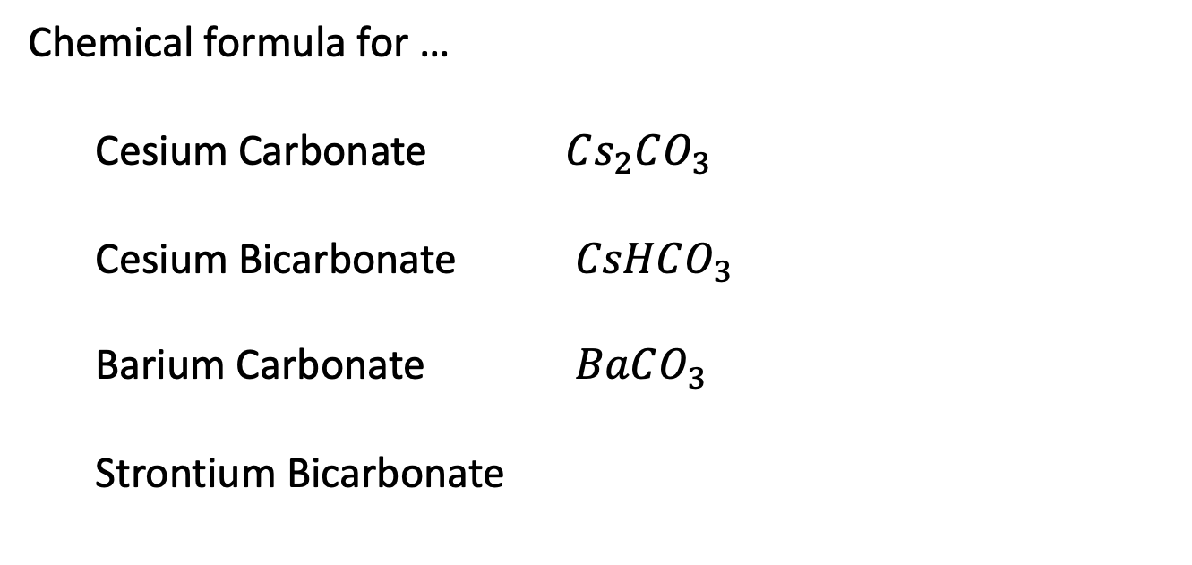
Principle of Using the principle of electrical neutrality to predict chemical formulas
Chemical formula for …
Cesium Carbonate $Cs_{2}CO_{3}$
Cesium Bicarbonate $CsHCO_{3}$
Barium Carbonate $BaCO_{3}$
Strontium Bicarbonate

Slide 30

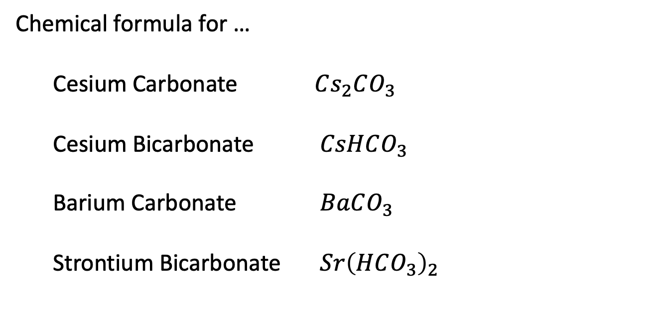


Using the principle of electrical neutrality to predict chemical formulas
Chemical formula for …
Cesium Carbonate $Cs_{2}CO_{3}$
Cesium Bicarbonate $CsHCO_{3}$
Barium Carbonate $BaCO_{3}$
Strontium Bicarbonate $Sr{\left(HCO_{3}\right)}_{2}$
$$HCO_{3}^{−}$$
$${Sr}^{2+}$$
$$HCO_{3}^{−}$$

Slide 31
Using the principle of electrical neutrality to predict chemical formulas
Chemical formula for …
Lithium Chloride
Rubidium Fluoride
Barium Bromide
Magnesium Iodide
Cations
Anions

Slide 32
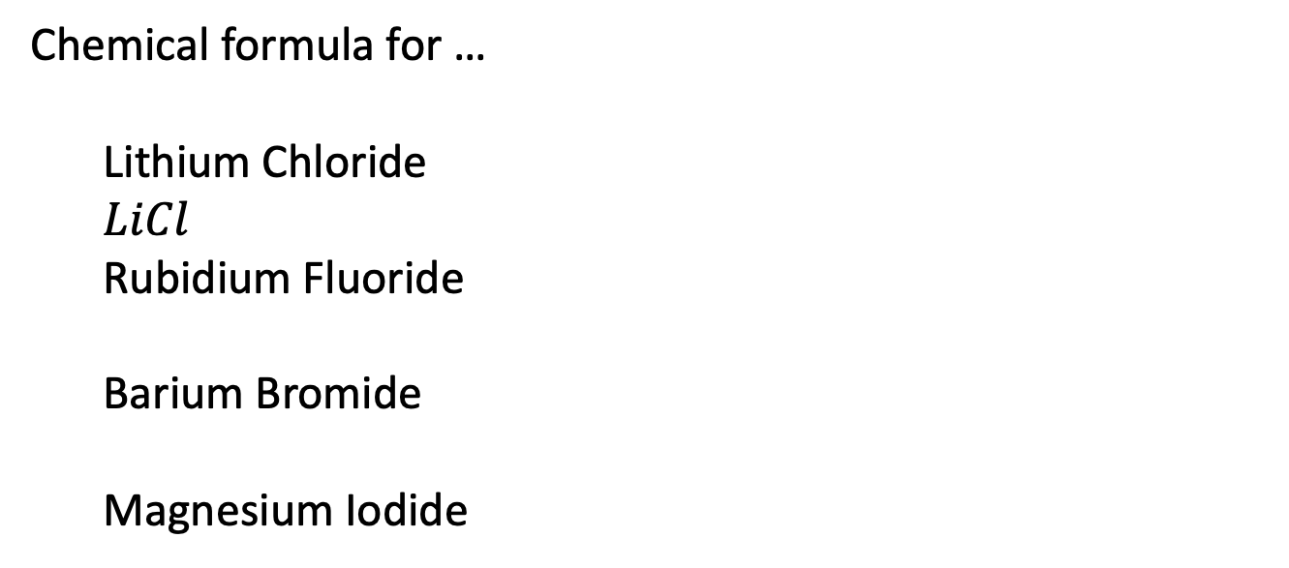
Using the principle of electrical neutrality to predict chemical formulas
Chemical formula for …
Lithium Chloride
$$LiCl$$
Rubidium Fluoride
Barium Bromide
Magnesium Iodide
Cations
Anions

Slide 33
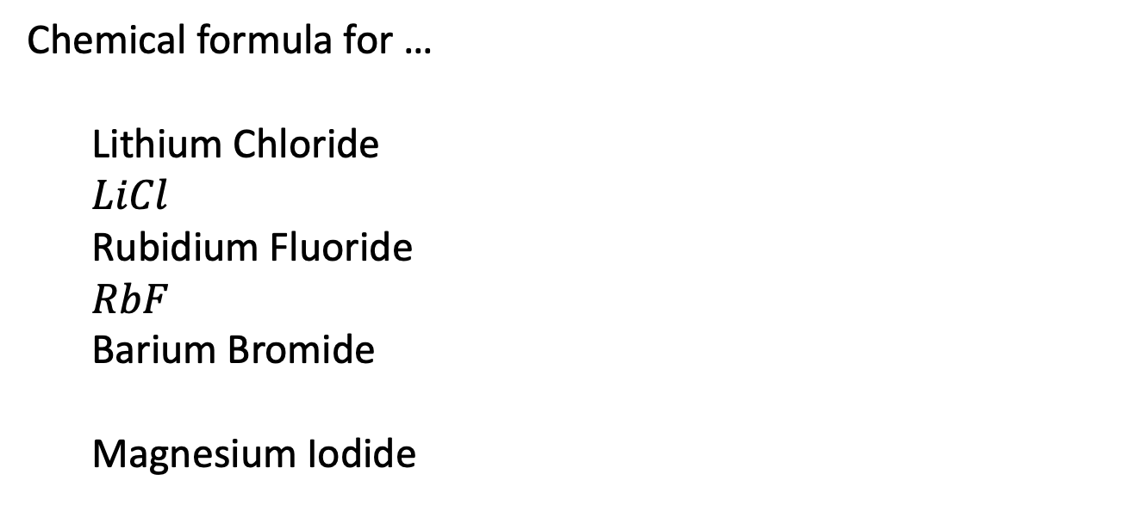
Using the principle of electrical neutrality to predict chemical formulas
Chemical formula for …
Lithium Chloride
$$LiCl$$
Rubidium Fluoride
$RbF$
Barium Bromide
Magnesium Iodide
Cations
Anions

Slide 34
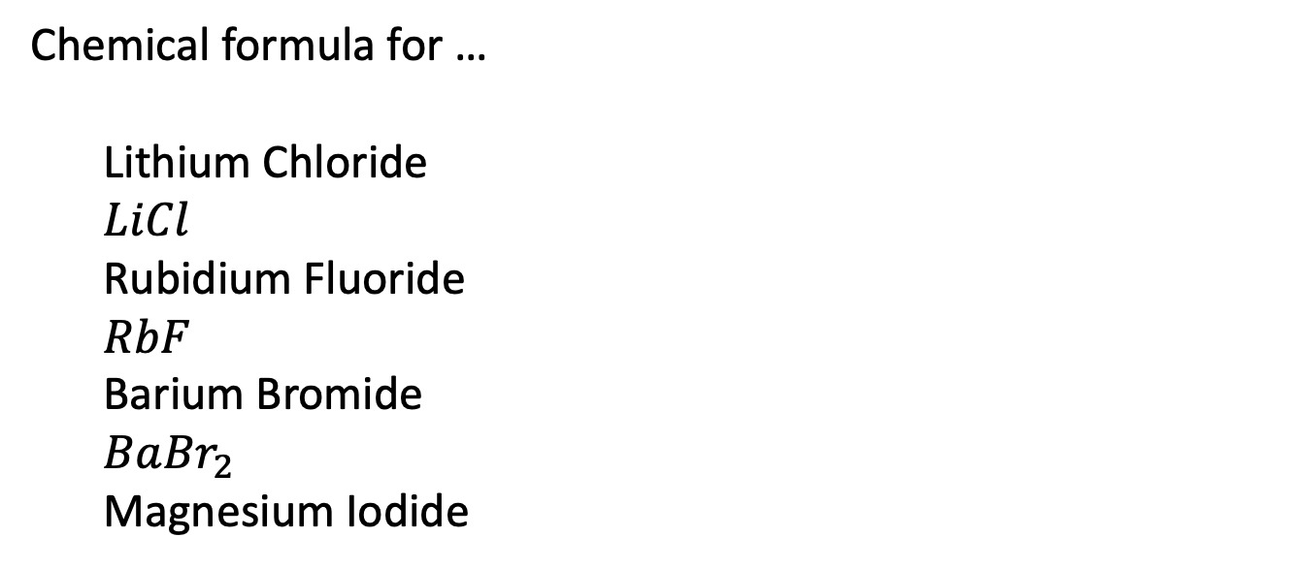
Using the principle of electrical neutrality to predict chemical formulas
Chemical formula for …
Lithium Chloride
$$LiCl$$
Rubidium Fluoride
$RbF$
Barium Bromide
$Ba{Br}_{2}$
Magnesium Iodide
Cations
Anions

Slide 35
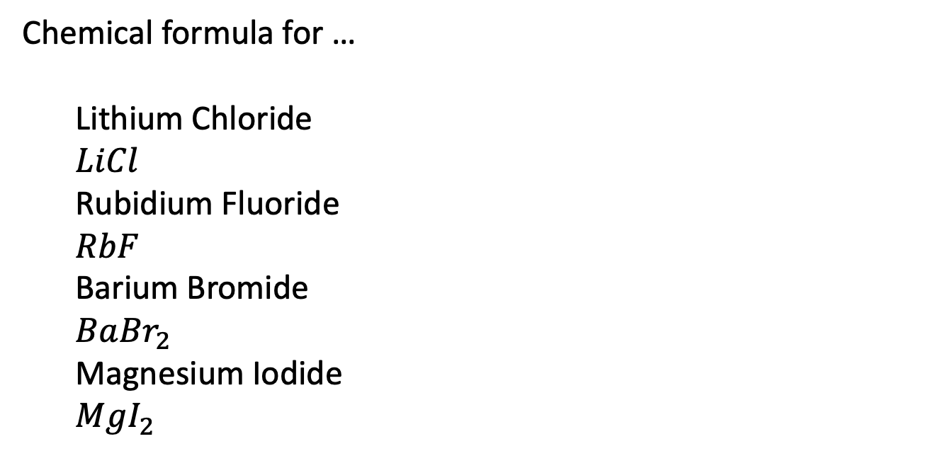
Using the principle of electrical neutrality to predict chemical formulas
Chemical formula for …
Lithium Chloride
$$LiCl$$
Rubidium Fluoride
$RbF$
Barium Bromide
$Ba{Br}_{2}$
Magnesium Iodide
$MgI_{2}$
Cations
Anions

